Slide 1

Liver Disease Prediction Using
Machine learning
Group 4
A Machine Learning Project
Team Members
Kiran Kumari
Kota Ashwitha
M. Bharath Kumar Reddy
Nethi Pranay
Vishnu Jith

Slide 2

Abstract
Liver disease is one of the leading
health issues World-wide.
Early prediction helps in proper
treatment and better chances of
recovery.
This project uses Machine Learning
to predict liver disease based on
medical data.
01
02
Data Preprocessing
EDA & Feature Analysis
Cleaned and transformed raw patient data
Comprehensive exploratory data analysis
03
04
Model Development
Performance Evaluation
Random Forest, Naive Bayes, Logistic Regression, SVM
Identified most effective predictive model

Slide 3


Problem Statement
Critical Health Challenge
Liver disease can be life-threatening if not diagnosed early. Traditional diagnostic methods may miss early-stage indicators, leading to delayed treatment and poor patient outcomes.
Healthcare Efficiency
Accurate prediction models can help healthcare professionals identify high-risk patients efficiently, optimizing resource allocation and improving screening protocols.
Build robust predictive models using comprehensive patient data
Evaluate performance in classifying liver disease categories
Address imbalanced classes and identify key diagnostic features

Slide 4

Dataset Description
615
13
1
12
Rows
Columns
Categorical
Variable
Numeric Variables
Data Source & Structure
Source: Liver Disease dataset (CSV, semicolon-separated)
Features: Multiple numerical Columns and one categorical Column including age, sex, albumin, bilirubin, liver enzymes, protein, and cholesterol levels.
Target Variable: Category (disease type classification)
Key Preprocessing Steps
Encoded sex column (m → 1, f → 0)
Replaced missing values with median for numerical features
Converted numeric strings to standardized format
Applied SMOTE for class imbalance correction

Slide 5

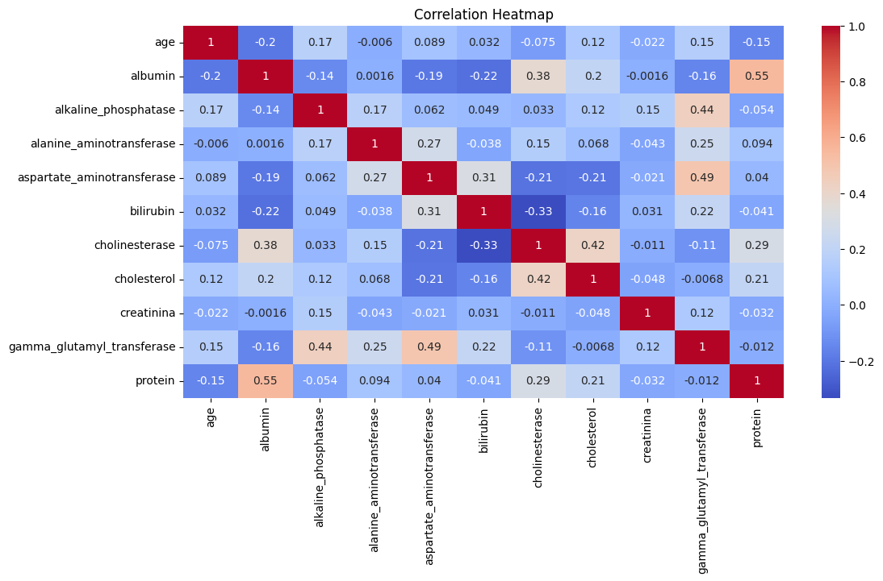



Methodology
1
Data Exploration
Examined dataset shape, data types, and missing values. Separated numerical and categorical features for targeted analysis
2
Missing Value Treatment
Replaced NA entries with NaN. Used median imputation for numerical features to maintain robustness against outliers.
3
Class Imbalance Correction
Applied SMOTE to generate synthetic samples for minority classes, ensuring balanced training data for accurate prediction.
4
Model Training & Evaluation
Split data 70/30, applied StandardScaler, trained multiple algorithms, and performed comprehensive performance evaluation.
Random Forest
Ensemble method with hyperparameter tuning
Naive Bayes
Probabilistic classifier for medical data
Logistic Regression
Linear approach for binary classification
Support Vector Machine
Optimal margin classification

Slide 6
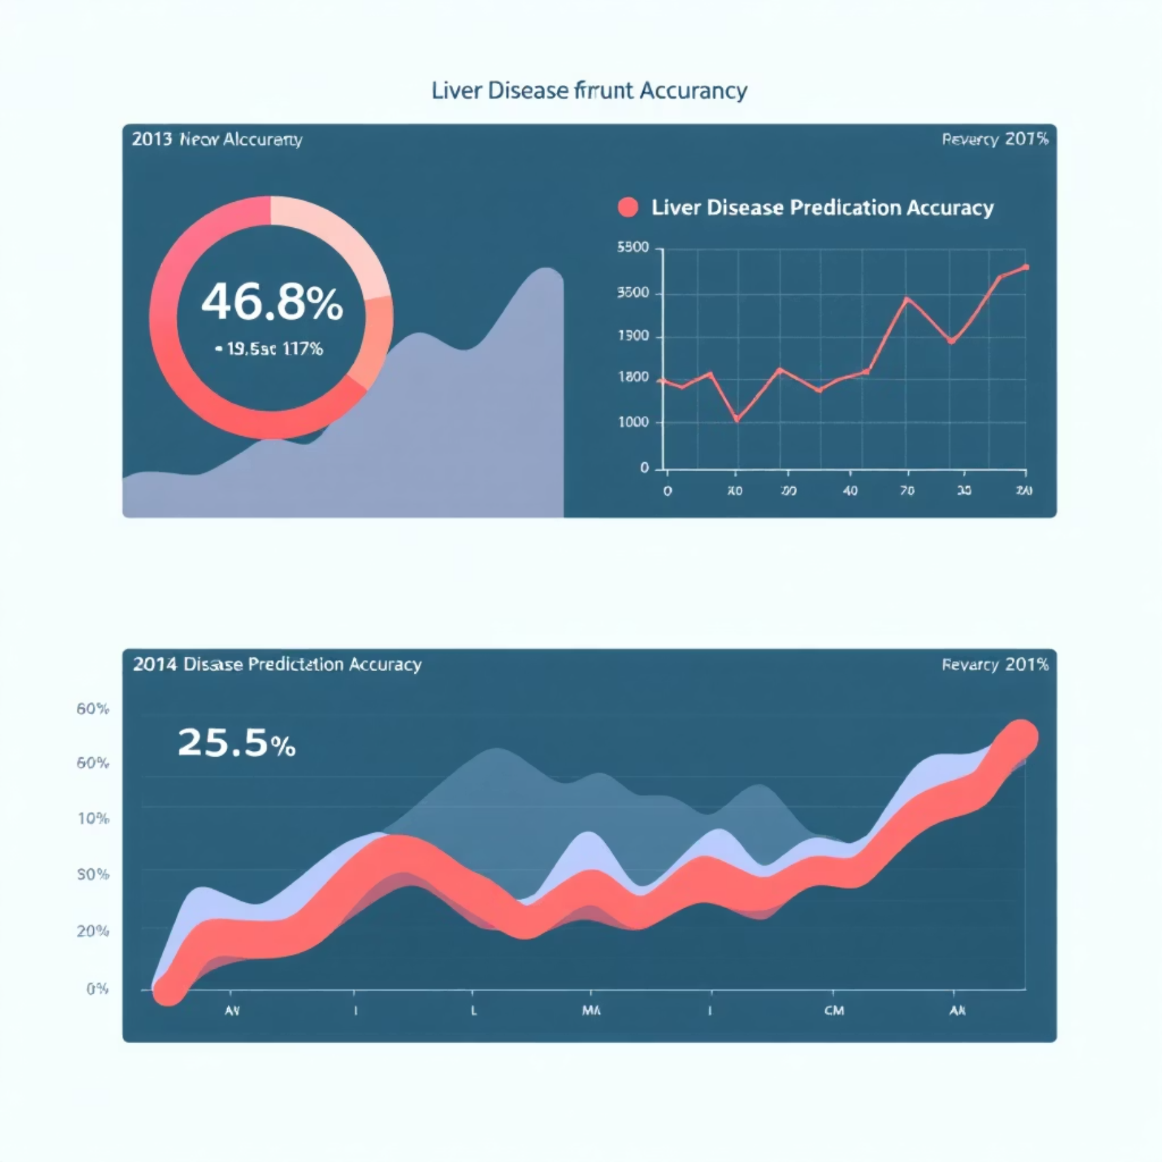
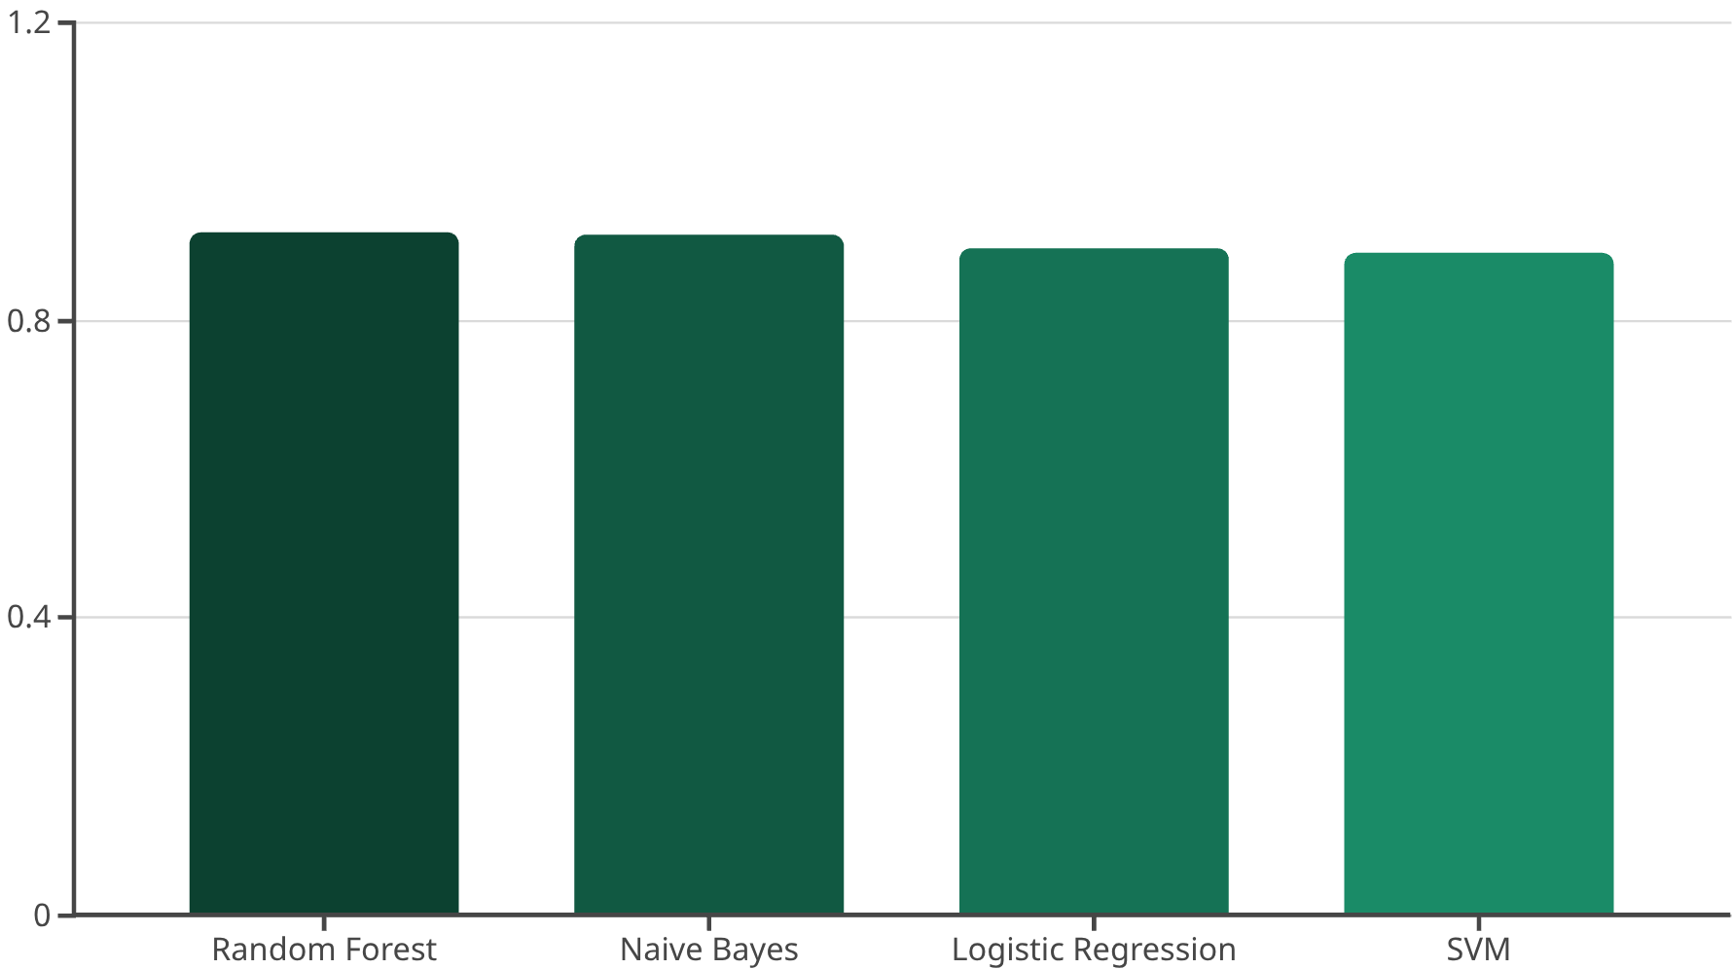



Results :
Model Performance Comparison
Class Distriibution Analysis
Feature Correlations
Cross-Validation Stability
Heatmap analysis identified strong correlations between liver enzymes and protein levels, confirming biological relevance.
Random Forest demonstrated consistent performance across multiple validation folds, confirming model reliability.
Count plots revealed significant class imbalance, validating the need for SMOTE implementation in our preprocessing pipeline.
5
Gamma Glutamyl Transferase

Slide 7





Conclusion
Project Success
Successfully implemented machine learning models to predict liver disease with high accuracy. SMOTE significantly improved performance for minority disease classes, reducing critical false negatives.
Model Excellence
Random Forest emerged as the most reliable model, achieving 91.89% accuracy while providing interpretable results through feature importance analysis.
Future Enhancements
Advanced Feature Engineering
Develop more sophisticated feature combinations
Ensemble Methods
Implement advanced ensemble techniques
Larger Datasets
Incorporate more comprehensive patient data
Impact: This research contributes to early liver disease detection, potentially improving patient outcomes through data-driven healthcare solutions.

Slide 8
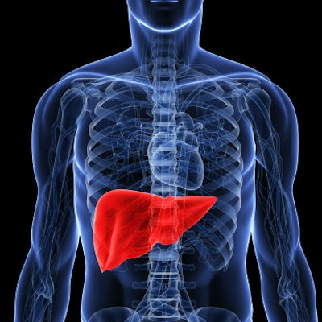
Future Enhancements
Advanced Feature Engineering
Develop more sophisticated feature combinations
Ensemble Methods
Implement advanced ensemble techniques
Larger Datasets
Incorporate more comprehensive patient data
Impact: This research contributes to early liver disease detection, potentially improving patient outcomes through data-driven healthcare solutions.

Slide 9


